Slide 1
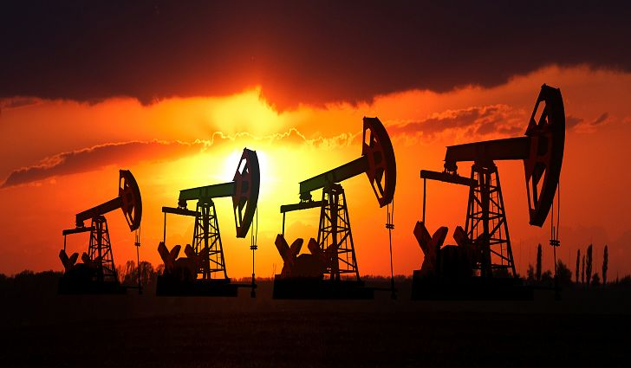
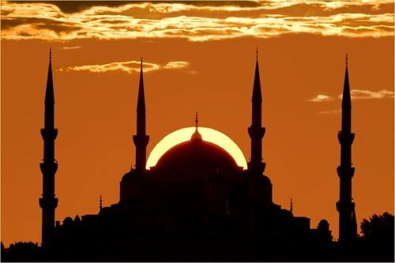


Slide 2
Oil, Islam, and Women - MICHAEL L. ROSS
American Political Science Review Vol. 102, No. 1 February 2008

Slide 3
The Problem
Women has made less progress in Middle East and Southern Asia than any other region.
Why?
Islam?
Oil?
Culture?

Slide 4
Resource (Oil/Mineral) Curse?
Oil production affects gender relations by reducing the presence of women in the labor force.
Higher fertility rates
Less education for girls
Less female influence within family
Less exchange of information, less collectiveness and less political and social representation.
Notes:
When growth encourages women to join the formal labor market, it ultimately brings about greater gender equality; when growth is based on oil and mineral extraction, it discourages women from entering the labor force and tends to exaggerate gender inequalities.

Slide 5
Resource (Oil/Mineral) Curse?
It also casts new light on the “resource curse.” Oil and mineral production has previously been tied to slow economic growth (Sachs and Warner 1995), authoritarian rule (Ross 2001a), and civil war (Collier and Hoeffler 2004). This paper suggests that oil extraction has even broader consequences than previously recognized: it not only affects a country’s government and economy but also its core social structures.
Islamic fundamentalism: a recent study of 18 countries found that when Muslim women had fewer economic opportunities, they were more likely to support fundamentalist Islam (Blaydes and Linzer 2006).
Notes:
What about Kazakhstan?

Slide 6
Why Female Labor Force Participation?
Helps raise female school enrollment and literacy: when families know that girls will be able to earn their own income—–and contribute to household income—–they tend to invest more in their health and education (Michael 1985).
It is also linked to lower fertility rates: when women earn their own incomes, they gain an incentive to delay the onset of parenthood, and hence bear fewer children over their lifetimes (Brewster and Rindfuss 2000).
Boost female political influence, promote an interest in politics, to join informal networks that facilitate collective action (Sapiro 1983; Schlozman, Burns, and Verba 1999).

Slide 7
Role of Resources in Female Participation Rate
After natural resource discovery (oil, gas, metals, coffee, cocoa etc.), Dutch Disease appears in those countries (Corden and Neary 1982).
Oil crowds out traded goods by two mechanisms.
Influx of foreign currency
Increasing demand for non-tradable goods like constructions, retail services etc.
Increasing exchange rate causes increasing demand for exported goods (tradable goods)
Draws labor away from tradable goods sector (agriculture, manufacturing) to non-tradable goods sector (constructions and retail).

Slide 8
How Does Dutch Disease Affect Female Participation?
1st Increasing wage will attract women to join the labor force.
2nd Increasing family income will reduce women to join the labor force.
The net effect is normally ambiguous but;
In many developing countries women are largely employed in low wage export oriented sectors and agriculture.
As a result of Oil Boom:
Demand for male labor increases in non-traded sectors. Also increasing family income reduces women’s incentive to work.
Demand for traded goods decreases, therefore women unemployment increases.

Slide 9
How Oil Production May Reduce Female Political Influence

Slide 10
Data and Methods (cont’d)
The main implication of the model is,
H1: A rise in the value of oil production will reduce female participation in the labor force.
H2: A rise in the value of oil production will reduce female political influence.
To explore these hypotheses, oil production and employment data for all countries from 1960 to 2002, and data on female political representation for 2002.
The analysis can tell us if the key variables in the model—–oil, female work patterns, and female political empowerment—–are statistically correlated.

Slide 11
Data and Methods
2 sets of estimation
The first uses a first-differences model with country fixed-effects, and employs pooled time-series cross-sectional data for all states between 1960 and 2002
The other uses a cross-national model with a between estimator and covers all states in the most recent 10-year period (1993–2002).
The dataset includes all 169 states that were sovereign in the year 2000, and that had populations over 200,000.

Slide 12
The Model
where i is the country, t is the year, x is a series of explanatory variables, and the right-hand side variables are lagged by 1 year.
the first-differences model looks at whether changes in the explanatory variables are associated with changes in the dependent variable. Because it focuses on changes, not levels, the model helps control for country heterogeneity.

Slide 13
Variables
independent variable is Oil Rents Per Capita which is a country’s total rents from oil and gas divided by its midyear population.
There are two dependent variables. One is Female Labor Force Participation, a variable that denotes the fraction of the formal labor force that is made up of female citizens.
The other dependent variable is female political influence, which I gauge with two variables: Female Seats, which measures the fraction of seats in each country’s parliament (or in bicameral systems, the lower house) held by women in 2002, and Female Ministers, which is the fraction of ministerial positions held by women in 2002
Notes:
2nd It is based on data collected by the International Labor Organization from national surveys and censuses, and released by the World Bank (2005a).

Slide 14
The models include several control variables:
Income
Income Squared*
Middle East, which is a dummy variable for the 17 states of the Middle East and North Africa.
Islam, a variable that measures the Muslim fraction of each country’s population
Communist, which is a dummy variable for the 34 states that had communist legal systems at some point since 1960
Working Age
Several measures of a state’s political institutions
Notes:
*which is the log of income squared, and is added to the regressions for Female Labor Force Participation to capture the U-shaped relationship produced by the combined effects of rising income on female wages (which encourages female labor participation) and unearned household income (which discourages female labor participation; Mammen and Paxson 2000)

Slide 19
Critiques
This dynamic can help explain the surprisingly low influence of women in mineral-rich states in the Middle East (Saudi Arabia, Kuwait, Oman, Algeria, Libya), as well as in Latin America (Chile), Sub-Saharan Africa (Botswana, Gabon, Mauritania, Nigeria), and the former Soviet Union (Azerbaijan, Russia).
Even though the vast majority of states showed increases in female representation, oil-producing states like Algeria, Norway, Russia and Kazakhstan—–all of which enjoyed a sharp rise in oil revenues—–saw a fall in female representation.
Russia 57.1, Kaza 67.9, Azer 63.1, Bost 71.9, Nigeria 48.3, Gabon 56.5, Chile 49.4
USA 56.3, Canada 61.4, Norway 61.2, World 50.3

Slide 20
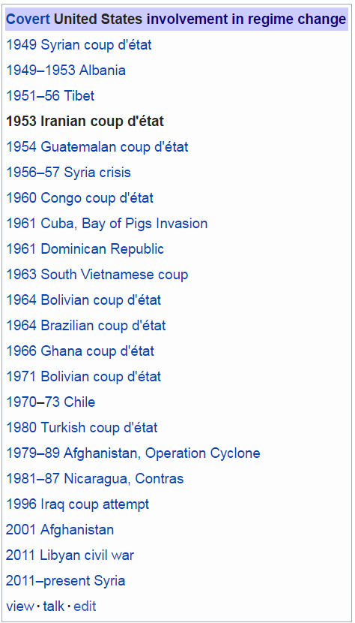
Disease but Dutch or ?
Intensive Resources
Oil
Beaches and wine
Oil
Gold, metals and fruits
Oil
Oil
Cigar
Oil, silver and metals
Oil, gold, zinc and metals
Iron, oil and many other things
Diamond, gold, oil, etc
Copper, gold
Gas, oil, gold etc*
Oil
Gas, oil, gold etc*
Oil
Oil
Notes:
*In 2010, US and Afghan government officials estimated that untapped mineral deposits located in 2007 by the US Geological Survey are worth between $900 bn and $3 trillion.^{[114]}

Slide 21
Guatemala 1954
Honduras 1903
Nicaragua 1912

Slide 22
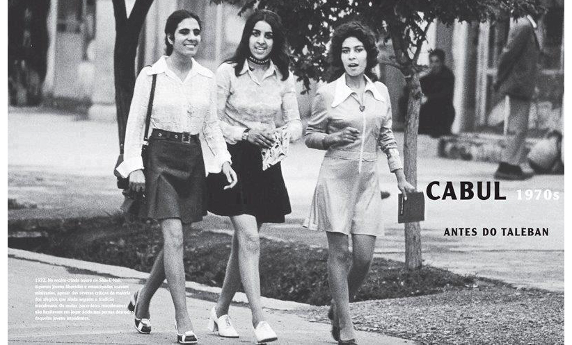
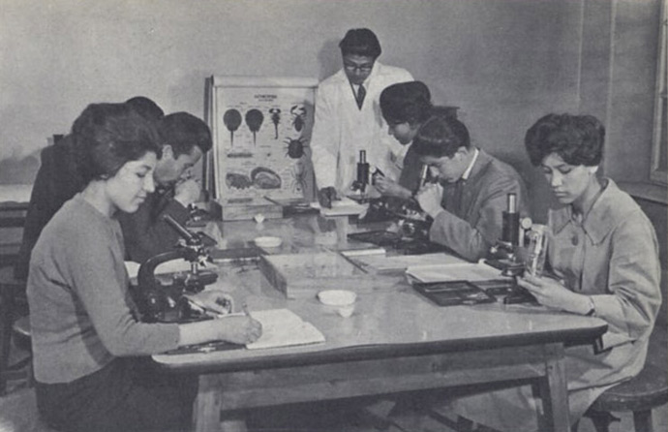
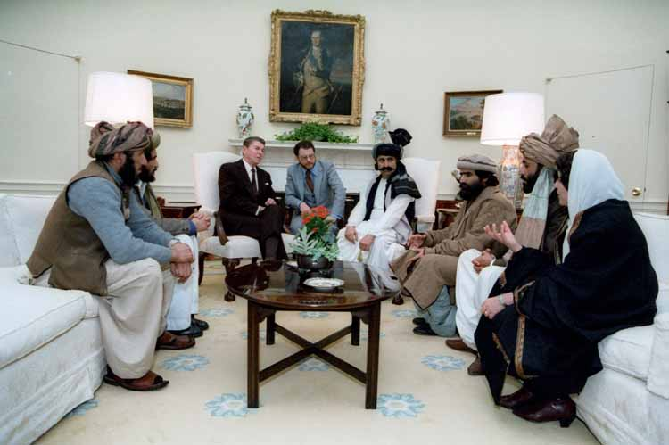
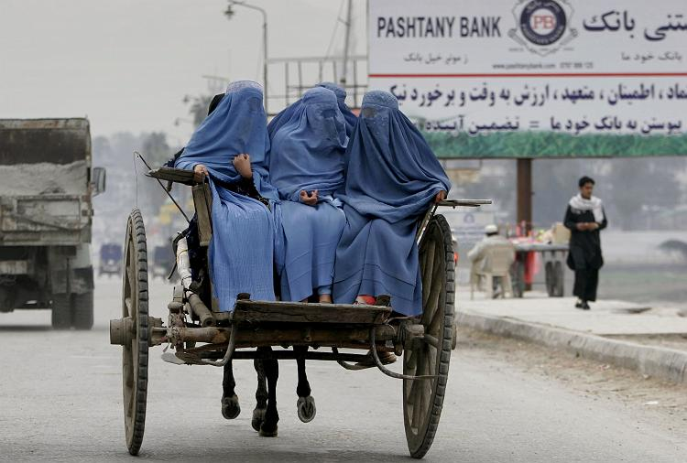

Slide 23

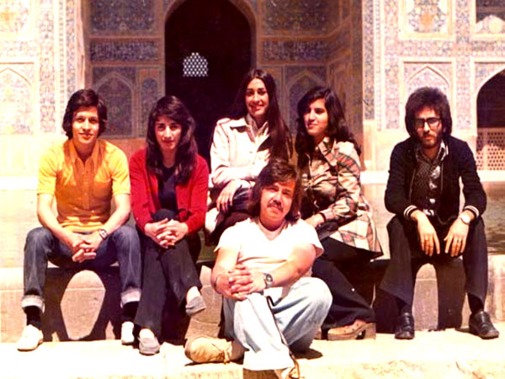
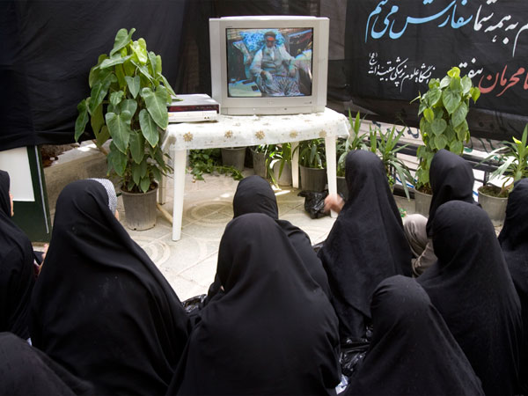

Slide 24
World’s top oil producers 2016
64
15
57
29
20
56
56
15
56
64
63
17
51
61
27
46
45
44
51
59
24
51
55
45
48
61
30
68
69
48
73

Slide 25
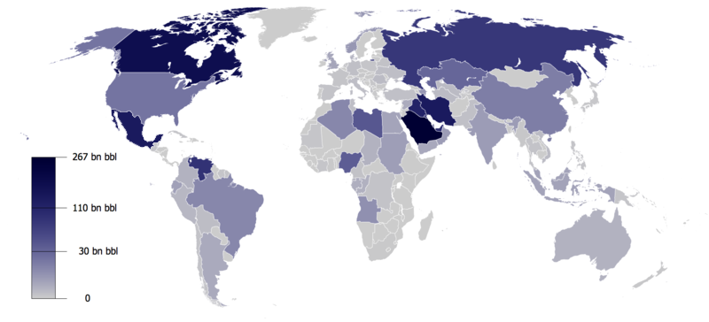
A map of world oil reserves according to OPEC, 2013

Slide 26
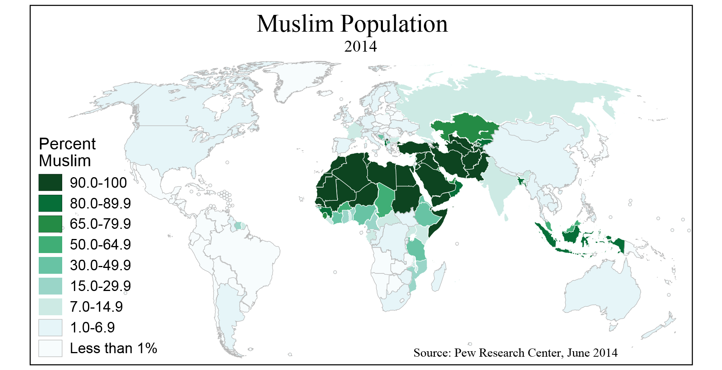

Slide 27
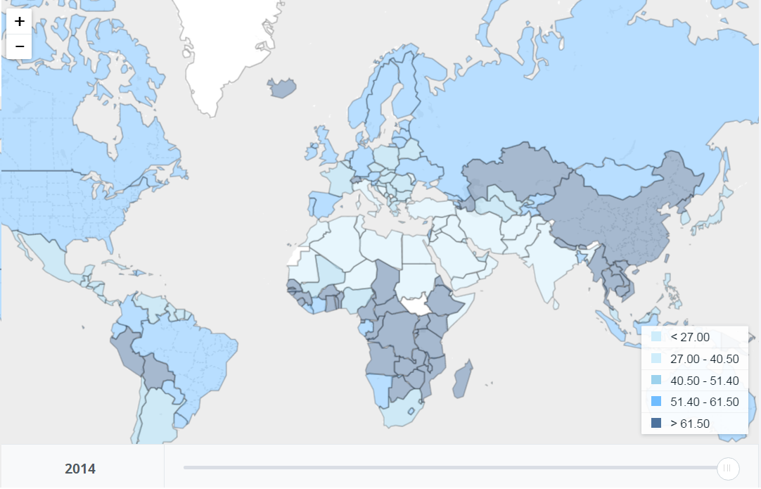
Labor force participation rate, female,2014, WB

Slide 28
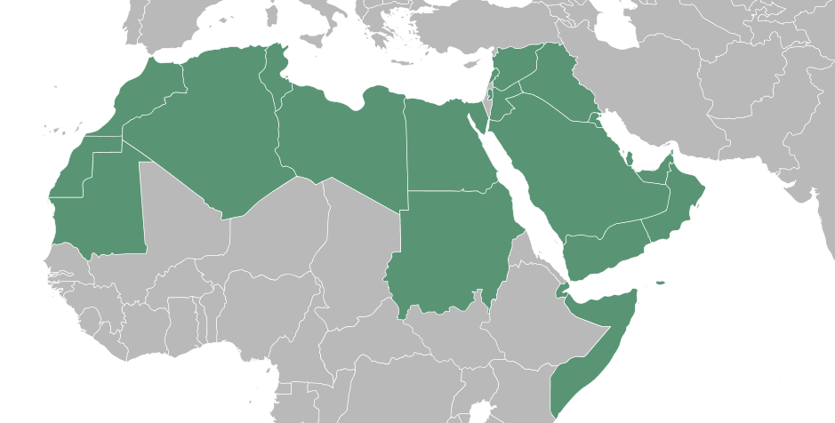
A map of the Arab world, wiki

Slide 29
Worst 20 Countries by FLPR, 2014, WB
Countries | FLPR | Arab | Islamic Republic | Ethnics
Syrian Arab Republic | 13,60 | + | + | A
Iraq | 15 | + | + | A
Algeria | 15,40 | + | + | A
West Bank and Gaza | 15,70 | + | + | A
Jordan | 15,80 | + | + | A
Afghanistan | 15,90 | - | + | Pashtun-Tajik (Persian)
Iran | 16,60 | - | + | Persian
Saudi Arabia | 20,40 | + | + | A
Egypt | 23,70 | + | + | A
Lebanon | 23,70 | + | + | A
Pakistan | 24,80 | - | + | Pun-Pash-Sindi
Tunisia | 25,20 | + | + | A
Yemen | 25,40 | + | + | A
Morocco | 26,70 | + | + | A
India | 27 | - | - | Everything
Mauritania | 28,90 | + | + | A
Oman | 29,30 | + | + | A
Turkey | 29,30 | - | - | Turkey Turks (influenced by Arabs and Persians)
Libya | 30 | + | + | A
Sudan | 31,40 | + | + | A

Slide 30
Exceptions of Oil Rich Arab States
 | FLPR | Arab | Islamic Republic
Bahrain | 39.1 | + | +
Kuwait | 43.8 | + | +
United Arab Emirates | 46.4 | + | +
Qatar | 50.1 | + | +
Bahrain
Kuwait
UAE
Qatar
Indians | 25,0
Nepalis | 13,5
Bangladeshis | 10,8
Filipinos | 10,0
Qataris | 12,0
Others Migrants | 28,7

